Slide 1
A Comparative Analysis of Income Level Prediction
Esad Kopru

Slide 2
Table of Contents
Data Exploration
Split Data into Training and Test
Classification:
Logistic Regression
Classification: Tree Based Classification
Classification: Random Forest
Classification: Linear SVM
Discussion and Conclusion

Slide 3
Data
The dataset is from 1994; census income
https://archive.ics.uci.edu/ml/datasets/Census+Income
14 attributes
32561 records.

Slide 4
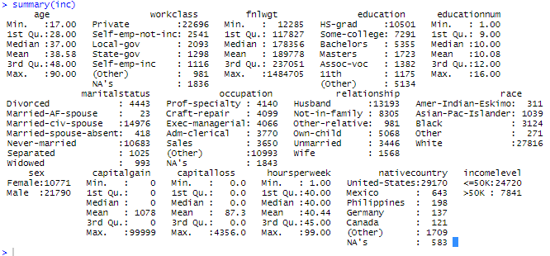
Data Exploration

Slide 5
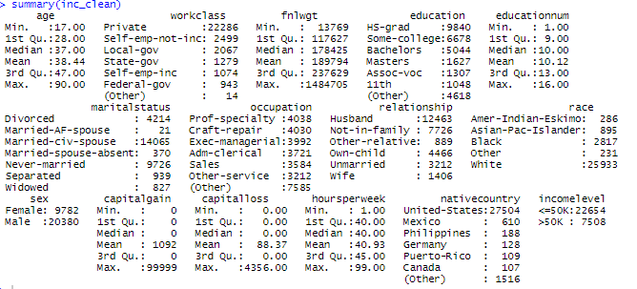
NA Values
First attempt was assigning average weights, however, later in the random forest analysis, the NA’s occurred again, so my second approach was to remove all NA values.
inc_clean <- DMwR::knnImputation(inc, k=5, scale=T, meth="weighAve")
summary(inc_clean)
inc_clean <- inc[complete.cases(inc), ]

Slide 6
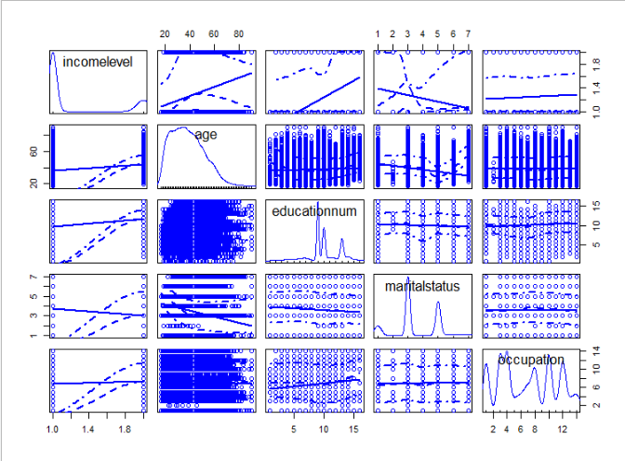
Data Exploration
Income level vs. age, education num, marital status; married people earns higher than single or widowed.
, occupation

Slide 7
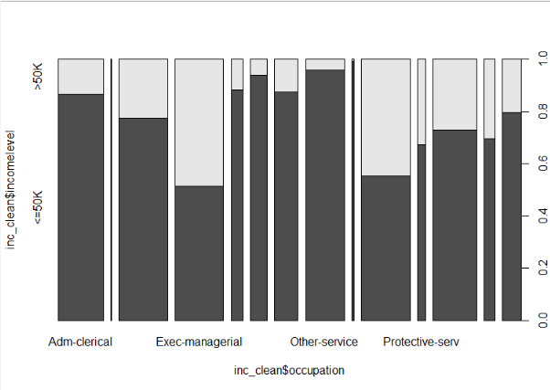
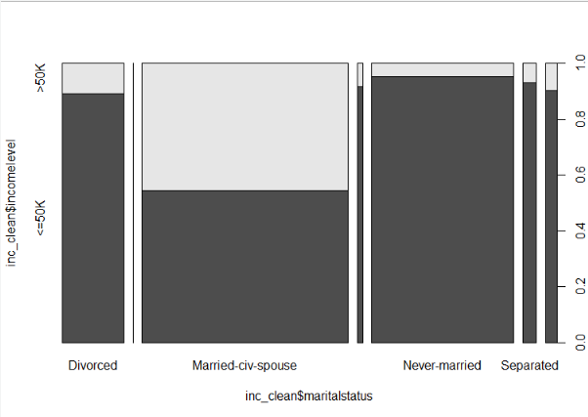
Income Level vs. Occupation, Marital Status

Slide 8
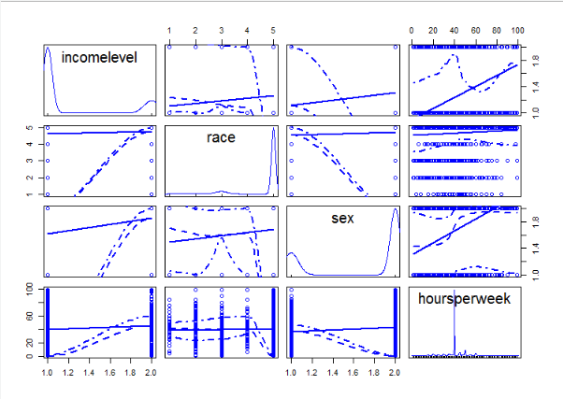
Data Exploration

Slide 9
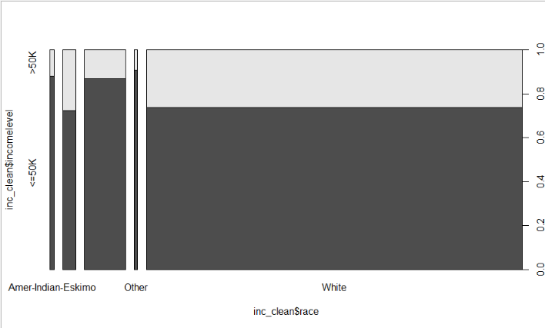
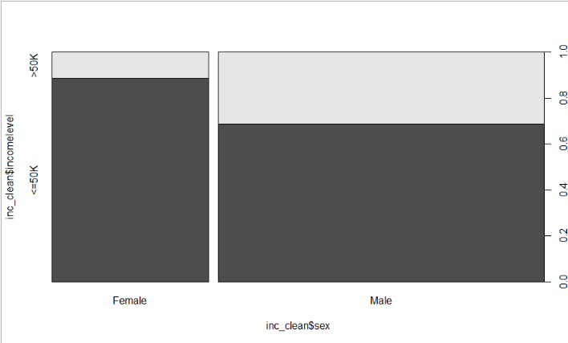
Income Level vs. Race, Gender

Slide 10
Divide dataset into Training and Test
set.seed(12345)
# split training and test datasets, 80% and 20%
train_sample <- sample(nrow(inc_clean), round(nrow(inc_clean)*0.8))
inc_clean_train <- inc[train_sample, ]
inc_clean_test <- inc[-train_sample, ]

Slide 11
Logistic Regression Model
log.base.model <- glm(incomelevel~., data=inc_clean_train, family="binomial")
vif(log.base.model) Error in vif.default(log.base.model) : there are aliased coefficients in the model
Education and educationnum are representing the same information, one with categorical and the latter is with numeric. So I removed the categorical education

Slide 12
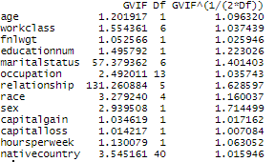
Logistic Regression Model 2
inc_clean <- inc_clean[,-4]
inc_clean_train <- inc_clean_train[,-4]
inc_clean_test <- inc_clean_test[,-4]log.updated.model2 <- glm(incomelevel~age+workclass+fnlwgt+educationnum+ occupation+relationship+race+sex+capitalgain+capitalloss+ hoursperweek, data=inc_clean_train, family="binomial")

Slide 13
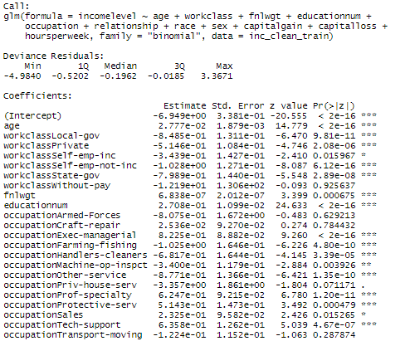
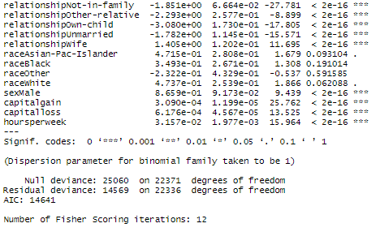
Final Logistic Regression model

Slide 14
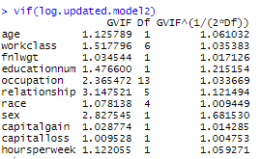
Final logistic regression model VIF

Slide 15
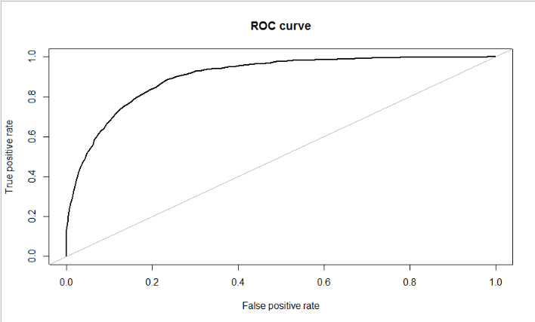
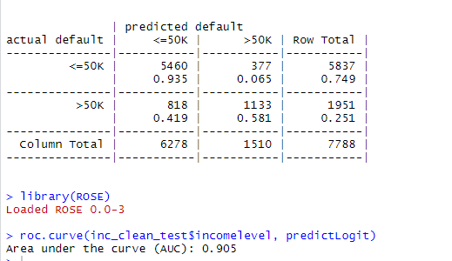
Logistic Regression model Evaluation
Misclassification => 818+377/7788 = 0.153

Slide 16
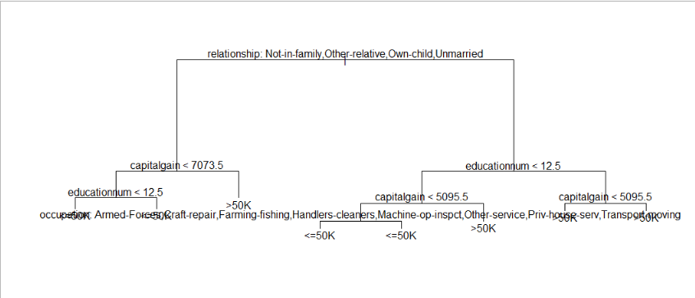
Tree based Classification
tree.incomelevel <- tree(incomelevel~., data=inc_clean_train)
Error in tree(incomelevel ~ ., data = inc_clean_train) :
factor predictors must have at most 32 levels

Slide 17
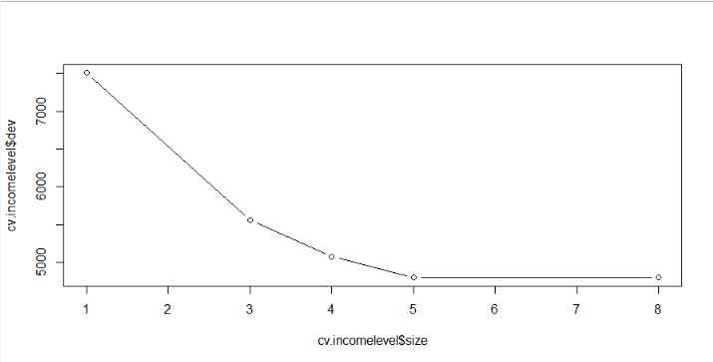
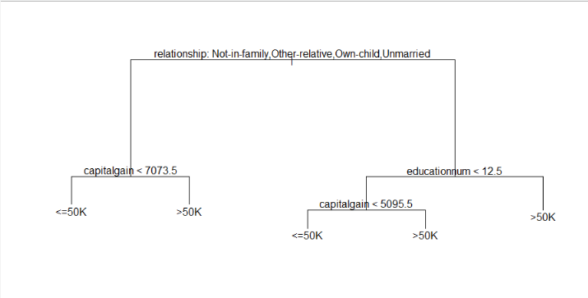
Pruning Tree

Slide 18
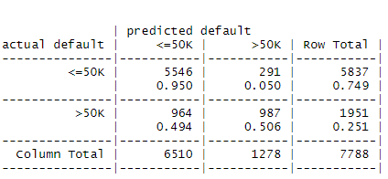
Tree Evaluation
Misclassification => 291+964/7788 = 0.1611

Slide 19
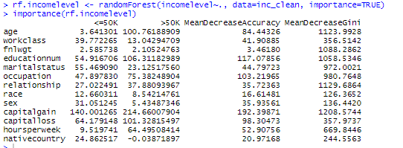
Random Forest Classification
The gini index shows that age, education, and the relationship are all important variables.

Slide 20
Random Forest Tuning
######### Tune Random Forest ###########
> mtry <- tuneRF(inc_clean_train, inc_clean_train$incomelevel, ntreeTry=10,
+ stepFactor=1.5,improve=TRUE, trace=TRUE, plot=TRUE, doBest=TRUE)
mtry = 3 OOB error = 0.16% Searching left ... mtry = 2 OOB error = 0.52% -2.190979
TRUE Searching right ... mtry = 4 OOB error = 0.09% 0.4730805 TRUE
rf2.incomelevel <- randomForest(incomelevel~., data=inc_clean_train, mtry=4,
importance=TRUE) > varImpPlot(rf2.incomelevel)

Slide 21
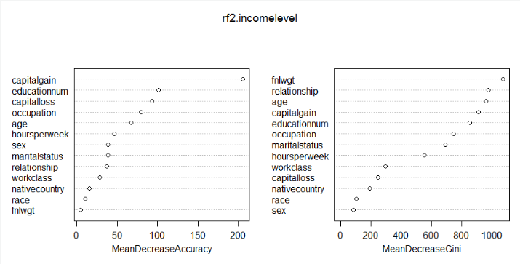
Random forest Variable Importance Plot

Slide 22
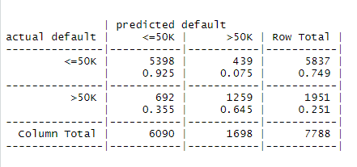
Random Forest Evaluation
Misclassification => 439+692/7788 = 0.1452

Slide 23
SVM Classification, Linear
svm.fit <- svm(incomelevel~.,data=inc_clean_train, cost=0.01, kernel='linear')
summary(svm.fit)

Slide 24
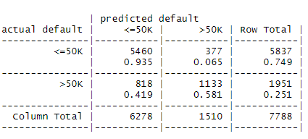
SVM Evaluation, Linear
Misclassification => 818+377/7788 = 0.1534

Slide 25
Comparison
Logistic Regression
Pruned Tree
Optimized Random Forest
Linear SVM
Misclassification => 818+377/7788 = 0.153
Misclassification => 291+964/7788 = 0.1611
Misclassification => 439+692/7788 = 0.1452
Misclassification => 818+377/7788 = 0.1534

Slide 26
Discussion and Conclusion
Fine tuning of SVM could perform better (both for linear and polynomial).
The tuned random forest model has the lowest classification rate (optimized mtry variable).
Logistic regression model is strong in predicting the income level.

Slide 27
References
https://archive.ics.uci.edu/ml/datasets/Census+Income
https://cloudxlab.com/blog/predicting-income-level-case-study-r/

